Slide 1
Intro to AI

Slide 2
Types of AI
Case based reasoning – Logic based systems based on stored cases
Expert Systems – Stored responses from experts
Autonomic response systems - Controllers
Knowledge Graphs – Data stored as RDF triples and used via rules
Neural Networks – Learning systems modelled after neurons in the brain.

Slide 3
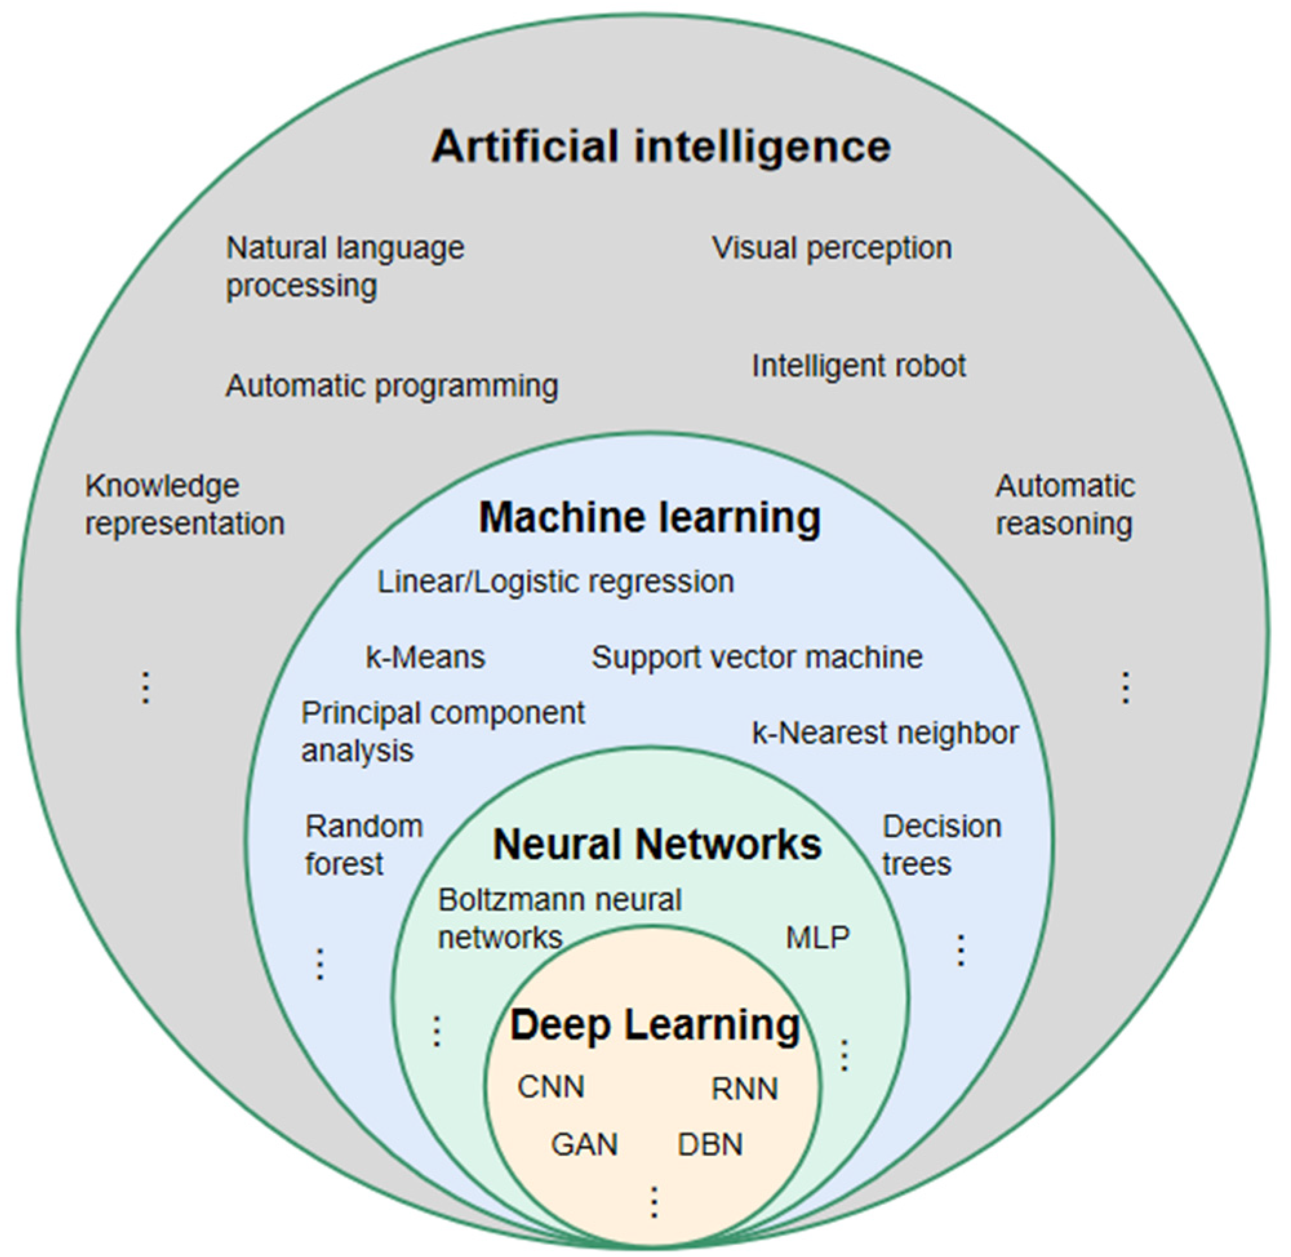
Types of AI
From: “A Comprehensive Review on Radiomics and Deep Learning for Nasopharyngeal Carcinoma Imaging”, Song Li, et al; 2021

Slide 4
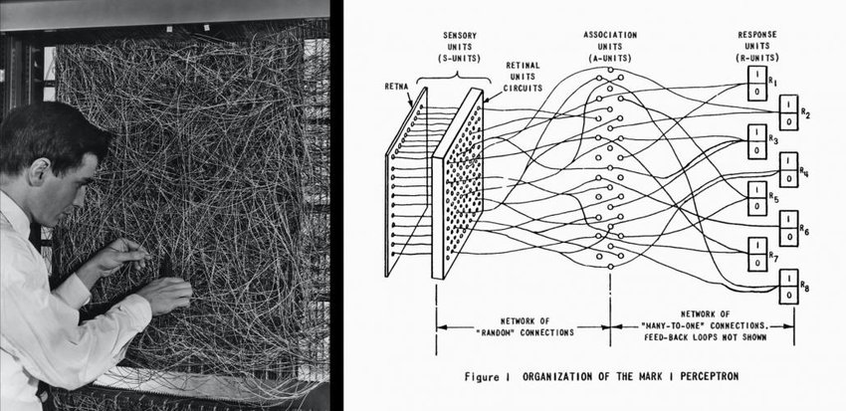
Neural Networks - Perceptron
In 1958 Frank Rosenblatt invented a machine called the perceptron
Image source: www.researchgate.com

Slide 5
Neural Networks - Perceptron
0 | 1 | 0 | 0
0 | 1 | 0 | 0
0 | 1 | 1 | 0
0 | 1 | 1 | 0
25 by 25 array of Photo sensors.
Put a number under the sensors
Where the lines of the number were, were lower.
Adjusted the dials until all of the values were the same
Recorded the values of the dials.
Later, after training, when a number was put under the sensors, the perceptron guessed that had the closest values was the same number.

Slide 6
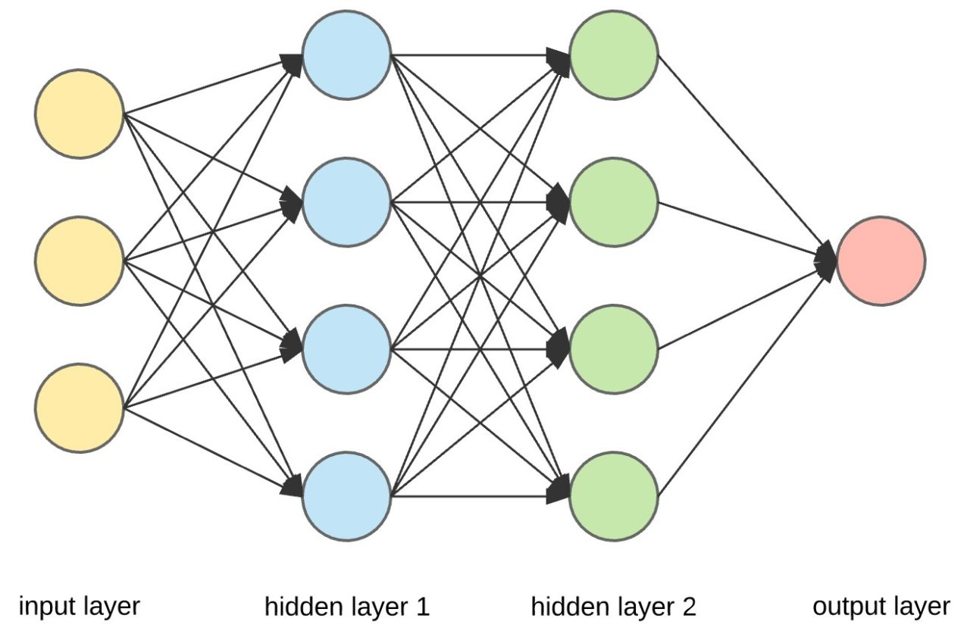
Neural Networks
Today’s neural networks are constructed the same way.
You will see the same
matrix is being used.
Each layer is a matrix
In between the layers is
weights.
Adjustment at the end is called a bias.
https://francescolelli.info/tutorial/neural-networks-a-collection-of-youtube-videos-for-learning-the-basics/

Slide 7
Neural Networks - Regression
Neural networks use regression
When the neural network (NN) doesn’t
get the right answer, that’s called its loss.
You They graph the loss
and try to minimize it.
This is called gradient descent
The neural network will take these
values and apply them to the nodes
In the matrices.
This is how a Learning Machine works.

Slide 8
Neural Networks – How it works
First acquire the data
Split the data into
Training data
Testing data
Use data
Run the AI.

Slide 9
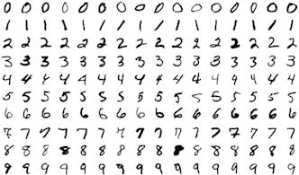
Neural Networks – Example
This uses the MNIST dataset
Each number is a separate
Image.
Each number is labelled
Image souce: https://en.wikipedia.org/wiki/File:MnistExamplesModified.png

Slide 10
Neural Networks – LLMs
Large Language Models
Turn the words into vectors – 32000 words
1 Cat
200 Car
10 Alligator
3 Dog
Related words are located near each other numerically
These numbers are poked into the matrices

